Slide 1
Entrepreneurship and New business creation
(2 ECTS, 50-60 h)
Notes:
Today's dynamic economy requires people who can take advantage of opportunities, take initiative and solve problems in creative ways. This course gives you the knowledge and skills to independently and critically approach the entrepreneurial processes that take place in all sectors of society, i.e. in businesses, in the public sector and in the civil society. It gives you tools to drive or facilitate entrepreneurship by starting your own business, developing local communities or to work with development processes in established companies, authorities, and non-profit organizations.

Slide 2
1. 1 Entrepreneurship and Small Business
1.1.1 Entrepreneurship and intrapreneurship
1.1.2 New ventures and small business
1.1.3 The demographics of entrepreneurship
1.1.4 The entrepreneur – notion and myths
Notes:
Entrepreneurship, as well as intrapreneurship, is a way of thinking and acting where you can use your passion for innovation whether you plan to start your own business, or plan to work within an organisation, or develop an understanding of business operations and leadership.

Slide 3
Global Entrepreneurship Monitor
ECONOMIC GROWTH
LEVEL OF ENTREPRENEURIAL ACTIVITY
Entrepreneurial
opportunity
Entrepreneurial
capacity
https://www.gemconsortium.org/
Demography
Education
Economic infrastructure
Culture
Notes:
The Global Entreprenurship Monotor (GEM) is a harmonised assessment of the level of national entrepreneurial activity in each of the participant countries. The programme was launched in 1999 in ten countries. By 2020 it had grown to 115 countries with over 200 000 annual interviews being conducted in each country.
The surveys look at two things: entrepreneurial opportunity (demand) and the entrepreneurial capacity (supply) of respondents. Without opportunity the capacity is wasted, and vice versa. These are in turn influenced by a nation’s culture, economic infrastructure, education and demography, which aro also explored int the surveys.

Slide 4
New venture creation
Total Early-stage Entrepreneurial Activity (TEA)
Potential entrepeneur
Attitudes
Nascent entrepeneur
Involved in setting
Owner - manager
New business up
Owner – manager
Skills
Knowledge
up a business for
less than 3 months
Business over 3.5
years old
to 3.5 years old
Creativity
Conception
Firm birth
Persistence
https://www.gemconsortium.org/
Notes:
GEM identifies potential entrepreneurs by asking individuals if they expect to start a business within the next three years.
The results are then categorises under three headings: 1) Nacent entrepreneurs who ar about to start up a business or have just done so within the last three months. In this stage the individual’s begin to commit resoruces, such as timer or money to start a business.
2) New owner –managers who already own or manage a business that has been established and is under 3.5 years old, The business are generating income and paying salaries or drawings.
3) The third group are Established owner–manager who already own or manage a business that has been established and is over 3.5 years old.

Slide 5
National Entrepreneurship Context index
Access to entrepreneurial finance
Government policy
Government entrepreneurship programmes
Entrepreneurship education
Research & development transfers
Commercial & professional infrastructure
Ease of market entry, burdens & regulations
Physical infrastructure
Social and cultural norms
https://www.gemconsortium.org/

Slide 6
National Entrepreneurship Context index
Top 10
Bottom 10
UAE
Saudi Arabia
Taiwan
India
Netherlands
Lithuania
Indonesia
Switzerland
Republic of Korea
Quatar
42. Puerto Rico
43. Guatemala
44. Mexico
45. Polen
46. Argentina
47. Tunisia
48. Brazil
49. Togo
50. Iran
51. Venezuela
https://www.gemconsortium.org/
GEM 2022/2023

Slide 7
GEM national reports
Global & other national reports
UK report
Notes:
Education increases a person’s human capital and numerous studies show a positive association between higher rates of education and increased levels of entrepreneurship. Based on the 2016 Annual Survey of Entrepreneurs in the USA, 51 percent of entrepreneurs in the USA had at least a bechelor’s degree while very few had not completed high school.
In the study of ’SuperEntrepreneurs’, 84 percent of these highly successfull entrepreneurs were found to have a college degree and they were five times more likely to hold a PhD than the general population.

Slide 8
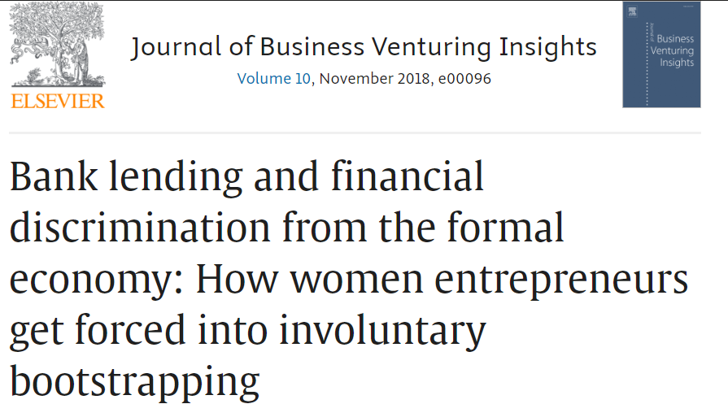
Female entrepreneurship
In many countries, worldwide, more than twice as many companies are started by men.
https://www.gemconsortium.org/
Notes:
Despite the trend of increasing female participation in the workforse, gender inequality in leadership positions is pervasive in most societies and the same is true for entrepreneurship. Studies shows that about one in three entrepreneurs were female. Lack of financial capital is one reason for that. Previous studies shows that women start businesses with 53 percent less capital than men.

Slide 9
Female entrepreneurship
GEM 2018/2019 women’s entrepreneurship report
Alison Rose Report Review of Female Entrepreneurship
Women in Enterprise report

Slide 10
Assignment
Access the latest GEM report for your country and discuss the findings.
What is the reason for gender inequality in entrepreneurship? How does it look likes in your country?

Slide 11
Acknowledgments
This Material is Part of the Education Package produced within the Erasmus+ Project: ENDORSE
Project Partners:
ENDORSE Educational Material Entrepreneurship © 2024 by ENDORSE is licensed under CC BY-SA 4.0
Logos of Partner Institutions and Erasmus+ are excepted.

