Slide 1
Entrepreneurship and New business creation
(2 ECTS, 50-60 h)
Notes:
Today's dynamic economy requires people who can take advantage of opportunities, take initiative and solve problems in creative ways. This course gives you the knowledge and skills to independently and critically approach the entrepreneurial processes that take place in all sectors of society, i.e. in businesses, in the public sector and in the civil society. It gives you tools to drive or facilitate entrepreneurship by starting your own business, developing local communities or to work with development processes in established companies, authorities, and non-profit organizations.

Slide 2
1. 1 Entrepreneurship and Small Business
1.1.1 Entrepreneurship and intrapreneurship
1.1.2 New ventures and small business
1.1.3 The demographics of entrepreneurship
1.1.4 The entrepreneur – notion and myths
Notes:
Entrepreneurship, as well as intrapreneurship, is a way of thinking and acting where you can use your passion for innovation whether you plan to start your own business, or plan to work within an organisation, or develop an understanding of business operations and leadership.

Slide 3
The antecedence of modern entrepreneurship
1755
Cantillon Introduced the concept of entrepreneur from ‘entreprendre’ (ability to take change)
1803, 1817
Say Emphasised the ability of the entrepreneur to ‘marshal’ resources in order to respond to unfilled opportunities.
1871/1981
Menger Noted the ability of entrepreneurs to distinguish between ‘economic goods’ – those with a market or exchange value – and all others.
1893
Ely and Hess Attributed to entrepreneurs the ability to take integrated action in the enterprise as a whole, combining roles in capital, labour, enterprise and entrepreneur.
1911, 1928, 1942
Schumpeter Envisioned that entrepreneurs proactively ’created’ opportunity using ‘innovative combinations’ which often included ‘creative destruction’ of passive or lethargic economic markets.
Notes:
The notion of entrepreneurs has been crafted over many centuries, starting with Cantillon 1755. Similar with Entrepreneurship, the notion of the Entrepreneur is not always clear cut. Notice that none of the above notions says nothing about starting a new venture or owning the enterprise…
There are two generally accepted explanations of where entrepreneurial opportunities com from: The Schumpeterian view and the Kirznerian view.

Slide 4
The antecedence of modern entrepreneurship; continued
1921
Knight Suggested that entrepreneurs were concerned with ‘efficiency’ in the use of economic factors by continually reducing waste, increasing savings and thereby creating value.
1948, 1952, 1967
Hayek Continued the Austrian tradition of analytical entrepreneurs, attributing to them capabilities of discovery and action, recognising the existence of information asymmetry which they could exploit.
1973, 1979, 1997, 1999, 2009
Kirzner Attributed to entrepreneurs a sense of ‘alertness’ to identify opportunities and exploit them accordingly.
1974
Ducker Attributed to entrepreneurs the capacity to ‘foresee’ market trends and make a timely response.
1975, 1984, 1985
Shapero Attributed a ’judgement’ ability to entrepreneurs to identify ‘credible opportunities’, depending on two critical antecedents – perceptions of ‘desirability’ and ‘feasibility’ from both personal and social viewpoints.
Notes:
The notion of entrepreneurs has been crafted over many centuries, starting with Cantillon 1755. Similar with Entrepreneurship, the notion of the Entrepreneur is not always clear cut. Notice that none of the above notions says nothing about starting a new venture or owning the enterprise…
There are two generally accepted explanations of where entrepreneurial opportunities com from: The Schumpeterian view and the Kirznerian view.

Slide 5
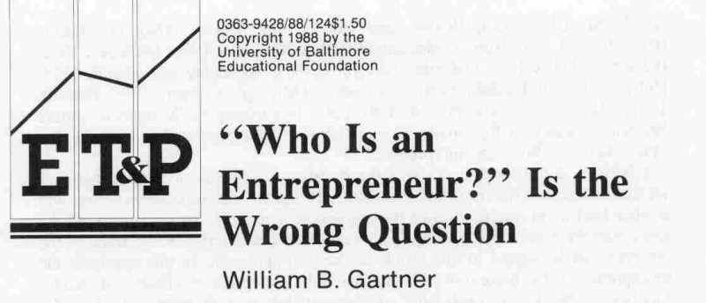
Definition of entrepreneurs
Entrepreneurs are defined by their actions -
they create and/or exploit change by innovations
Criticism of having focus only on the entrepreneur - it's about processes.
criticism of having focus only on the entrepreneur - it's about processes
Notes:
Despite a long tradition of research – there are criticism of having focus only on the entrepreneurs – instead research’ recommendation on entrepreneurial processes

Slide 6
Different kind of entrepreneurs
“Traditional” entrepreneur - create and/or exploit change for profit, by innovating, accepting risk & moving resources to areas of higher return
Social entrepreneur - working with social purposes ( social enterprises)
Intrapreneur – A change makers within an enterprise
Civic/societal entrepreneur – A change maker in the society

Slide 7
Myths about entrepreneurs
They have good ideas & you don’t
They are extraordinary forecasters
They are risk takers
They have money & you don’t
They are visionary
They are not like the rest of us
See Lesson 1.2 Entrepreneurial mindset

Slide 8
Being an entrepreneur
TED talk by Mark Leruste

Slide 9
Assignment
Write a report on the background & history of an entrepreneur who set up & grew their own business, outlining the reasons for the success’
Write a report on the background & history of an established social enterprise, outlining the reasons for its success

Slide 10
Acknowledgments
Part of the Education Material produced within the Erasmus+ Project: ENDORSE
Project Partners:
ENDORSE Educational Material Entrepreneurship © 2024 by ENDORSE is licensed under CC BY-SA 4.0
Logos of Partner Institutions and Erasmus+ are excepted.

