Slide 1
Entrepreneurship and New business creation
(2 ECTS, 50-60 h)
Notes:
Today's dynamic economy requires people who can take advantage of opportunities, take initiative and solve problems in creative ways. This course gives you the knowledge and skills to independently and critically approach the entrepreneurial processes that take place in all sectors of society, i.e. in businesses, in the public sector and in the civil society. It gives you tools to drive or facilitate entrepreneurship by starting your own business, developing local communities or to work with development processes in established companies, authorities, and non-profit organizations.

Slide 2
1.2 The Entrepreneurial mindset
1.2.1 Character traits of entrepreneurs
1.2.2 Entrepreneurial behaviour
1.2.3 Cultural influences on creativity
Notes:
The term ’entrepreneurial mindset’ refers to the cognitive processes that are reflected in the conscious behaviour, decisions and approaches to management of an entrepreneur. Numerous studies have found links between entrepreneurship and psychological models of personality and character traits.

Slide 3
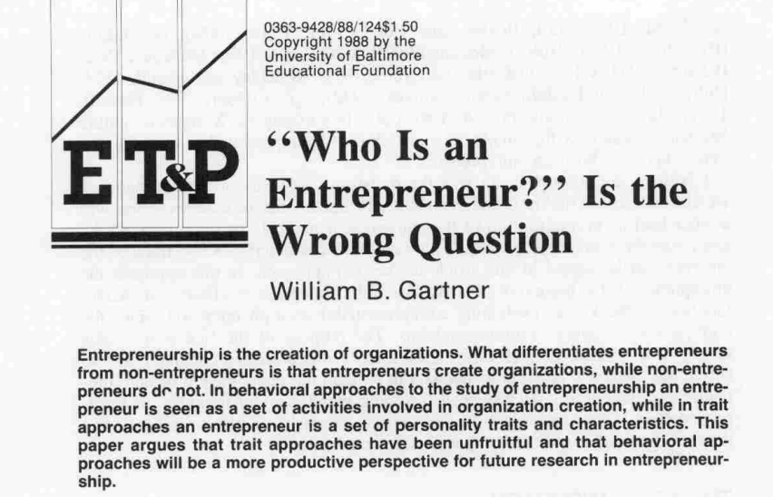
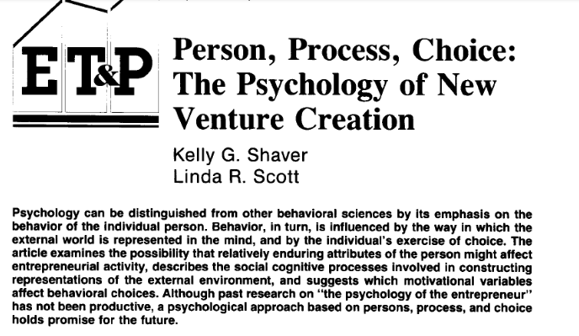
Person or Process?
Criticism of too much focus on the person/entrepreneur
Gartner (1988)
Shaver & Scott (1992
Notes:
However, before the various character traits of entrepreneurs are reviewed, it should be mentioned that there is also a criticism of too much focus on the person/entrepreneur, and that the focus should instead be placed on the entrepreneurial processes.

Slide 4
Character traits of entrepreneurs
High need for independence
High need for achievement
High creativity, innovation & opportunism
High internal locus of control
High acceptance of measured risk & uncertainty
High drive & determination

Slide 5
High need for independence
You are likely to be a person who:
Prefers to work alone & ‘do their own thing’
Likes to make up their own mind & not bow to pressure
Can be seen as stubborn & determined
Prefers to do ‘unconventional’ things
Notes:
”A need of be your own boss”’.
Amabile (1997) Motivating Creativity in Organizations: On Doing What You Love and Loving What You Do
Carter, N. M., Gartner, W. B., Shaver, K. G., & Gatewood, E. J. (2003). The career reasons of nascent entrepreneurs. Journal of business venturing, 18(1), 13-39.

Slide 6
High need for achievement
You are likely to be a person who:
Restless & energetic
Proactive rather than reactive
Decisive & quick acting
Goal orientated
Task & results orientated
Persistent & determined
Forward looking & self-sufficient
Optimistic rather than pessimistic
‘On the go’ all the time
Notes:
McClelland, D.C. (1961). The Achieving Society. Princeton, NJ: van Nostrand.
McClelland, D. C. (1965). N achievement and entrepreneurship: A longitudinal study. Journal of personality and Social Psychology, 1(4), 389.

Slide 7
High internal locus of control
You are likely to be a person who:
Believes they control their own destiny & discounts fate
Believes they create their own luck by hard work and effort
Is self-confident & shows considerable determination
Be willing to take advantages of opportunities that present themselves
Notes:
“perceived locus of control might be a predictor of entrepreneurial intentions”.
Brockhaus, R. H. (1975, August). IE locus of control scores as predictors of entrepreneurial intentions. In Academy of Management Proceedings (Vol. 1975, No. 1, pp. 433-435). Briarcliff Manor, NY 10510: Academy of Management.

Slide 8
High drive & determination
You are likely to be a person who:
Is proactive rather than reactive
Acts decisively & quickly
Sets achievable goals & then
works hard to achieve them
Is persistent & determined
Continues in a task despite setbacks
Is ‘on the go’ all the time
Is restless & easily bored
Notes:
This traits can also have downsides. Entrepreneurs are often seen as resltess and easily bored with their focus easily shifted. They may seem to do things at twice the pace of ohters and are unwilling or unable to wait for others to complete tasks set for them.

Slide 9
High creativity & innovative
You are likely to be a person who:
Is curious & questioning
Is intuitive & imaginative
Is innovative with an abundance of ideas
Is a bit of a daydreamer
Enjoys change & the challenges it poses
Notes:
Wennekers, S., & Thurik, R. (1999). Linking entrepreneurship and economic growth. Small business economics, 13, 27-56.

Slide 10
High acceptance of risk & uncertainty
You are likely to be a person who:
Make decisions quickly
Can act on incomplete information evaluating likely costs against benefits
Accurately assess their capabilities & then sets challenging but attainable goals
Is neither over nor under ambitious
Notes:
Segal, G., Borgia, D., & Schoenfeld, J. (2005). The motivation to become an entrepreneur. International journal of Entrepreneurial Behavior & research, 11(1), 42-57.

Slide 11
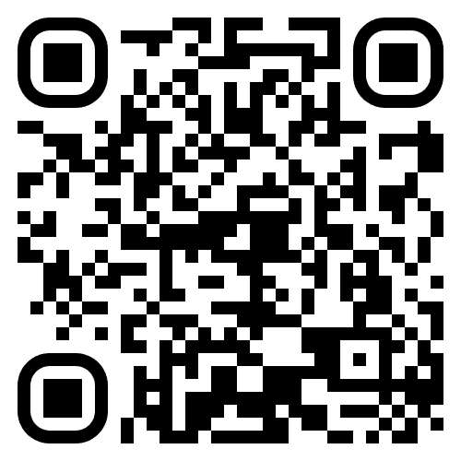
Measuring Entrepreneurial tendency - GET2 test
Personality tests
Need for independence
Need for achievement
Locus of control
Creativity & innovation
Willingness to take risks & live with uncertainty
Notes:
The General Enterprise Tendency (GET) tst measures an individual’s entrepreneurial tendency – how much they are inclined towards entrepreneurial activity based on five established entprepreneurial characters and traits.

Slide 12
Assignment
Take the GET2 test & discuss the results with friends who know you well. Do they recognize these characteristics & the associated behaviours in you? Reflect on the influences that might have contributed to your character.
Are you an Entrepreneur?

Slide 13
Acknowledgments
This Material is Part of the Education Package produced within the Erasmus+ Project: ENDORSE
Project Partners:
ENDORSE Educational Material Entrepreneurship © 2024 by ENDORSE is licensed under CC BY-SA 4.0
Logos of Partner Institutions and Erasmus+ are excepted.

