Slide 1
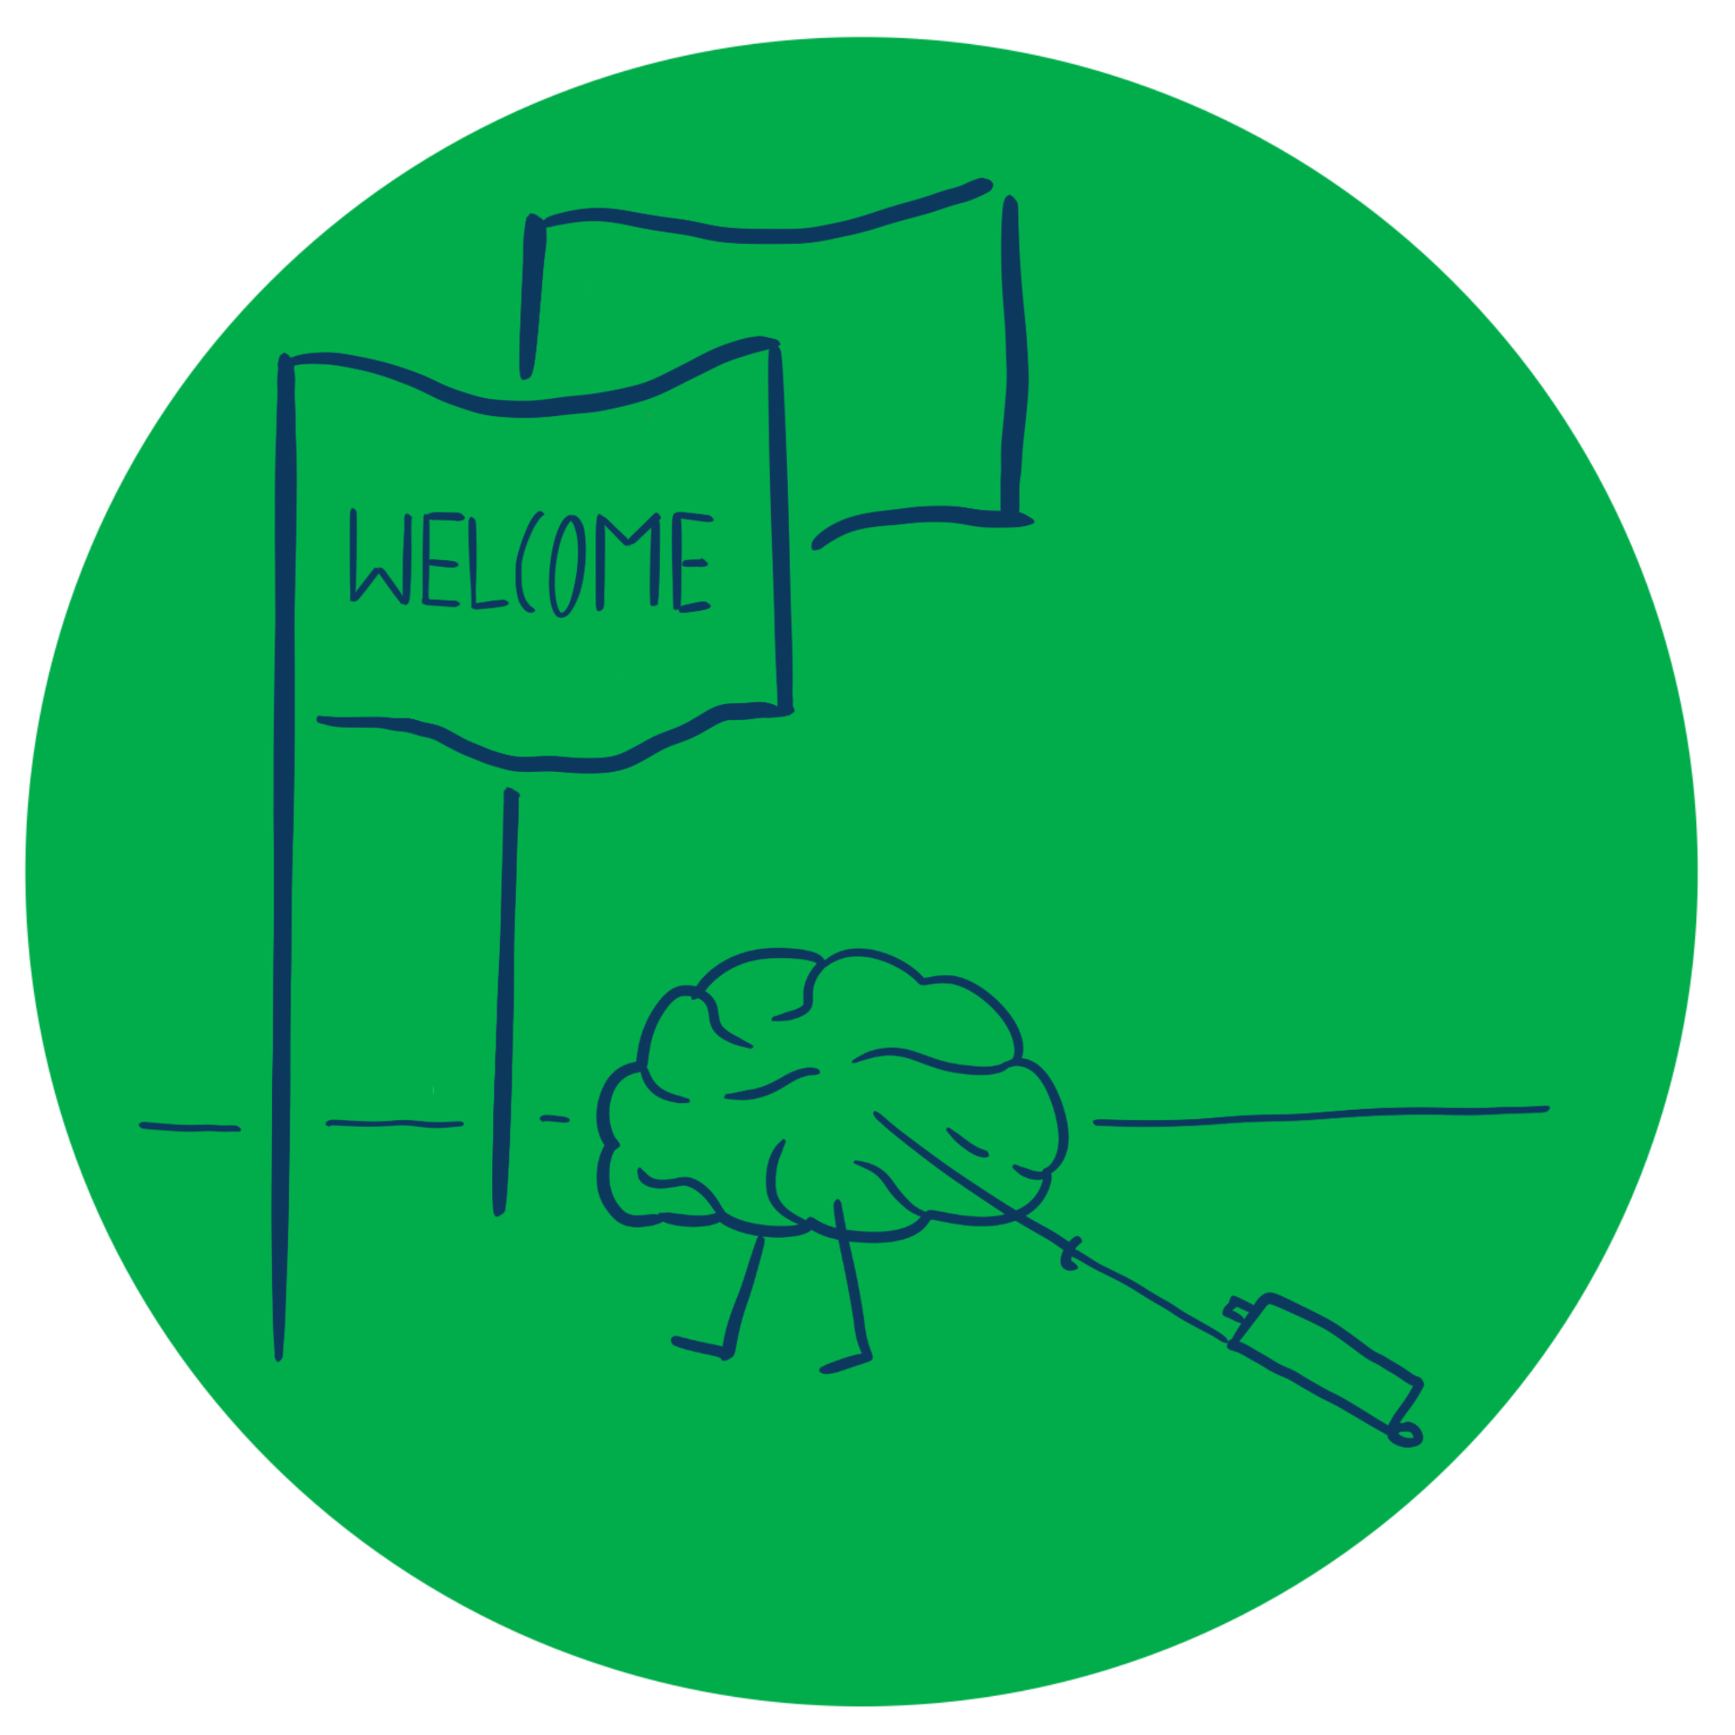
Entrepreneurship and New business creation
(2 ECTS, 50-60 h)
Notes:
Today's dynamic economy requires people who can take advantage of opportunities, take initiative and solve problems in creative ways. This course gives you the knowledge and skills to independently and critically approach the entrepreneurial processes that take place in all sectors of society, i.e. in businesses, in the public sector and in the civil society. It gives you tools to drive or facilitate entrepreneurship by starting your own business, developing local communities or to work with development processes in established companies, authorities, and non-profit organizations.

Slide 2
1. 2 The Entrepreneurial mindset
1.2.1 Character traits of entrepreneurs
1.2.2 Entrepreneurial behaviour
1.2.3 Cultural influences on creativity
Notes:
One of the problems with many of the studies into entrepreneurial character tratis is that entrepreneruship itselt is not consistently defined. Some studies has focused on nascent entrepreneurs, some have focused on those who actuallu enter self-employment and some on those entrepreneurs who run succesful businesses. Multivariate studies have failed to identify a strong causal link between a singel trait and entrepreneurship.
Remember that the impetus towards entrepreneurship is influenced by an individual’s personal situation (push and pull factors) as well as barriers.
Previous studies conclud that that personality theories do not offer sufficient explanation on why some individuals engage in entrepreneurial behaviour, while other do not.

Slide 3
Five-Factor (Big Five) Model
Openness – creativity, change, diversity & new experiences
Extraversion – outgoing, talkative, energetic social interaction
Conscientiousness – self-regulating, self-disciplined, achievement orientated
Agreeableness – harmony, altruism, trusting, not competitive
Neuroticism – fear, guilt, worry, stress
Notes:
Possible because of these criticism, more recent studies have focused on established psychological models to see whether entrepreneurs have certain distinguishing characteristics. The five-factor model is widely accepted in psychological studies, and meta-analysis have consistently found robust linkages between these personality traits and entrepreneurship. Both the intentions to start up a business and the performance.
The five factors in the model are: Openess, conscientiousness, extraversion, agreeableness and neuroticism.

Slide 4
Cognitive theory
The theory of cognitive development gives an insight into how character traits develop.
Cognitive theory shifts the emphasis from the individual and their inherent traits toward the situations that have led to their development.
CT provides an insight into how the pshychological factors that form part of our character and push or pull or restrain us from acting, might have developed through our life experiences.
CT seeks to understand how mental models influence behaviour and how these models influence decision-making by creating mental ’short-cuts’.
Mental models influence our behaviour
Notes:
The theory of cognitive development gives us an insight into how character traits develop. Jean Piaget (1896-1980) is usually credited with the origins of the theory. Piaget saw children’s cognitive development as being influenced both by biology and early environmental experience. Children construct mental models of how the world around them operates and these models change as they experience discrepancies between the real world an their mental models. They may start with certain models butt these are influenced and shaped over time by how the invironment around them reacts and how it functions.

Slide 5
Cognitive theory & behaviour
System 2: Left-brain
System 1: Right-brain
Logical
Analytical
Rational
Convergent
Linear
Disciplined
Seeks answers
Thinks in numbers or words
Use existing structure
Relies on past experiences
Concentrates on what is ‘relevant’
’Adaptors ’
Thinkers
’Want to doing things better’
Working alone
Intuitive
Emotional
Value-based
Imaginative
Divergent
Creative
Innovative
Seeks questions
Thinks in pictures
Does things differently
Accepts discontinuous leaps
’Innovators’
Quick decision-making
Working in groups
Notes:
To explain how cognitive theory might explain our behaviour - and therefore how it might explain the behaviour of entrepreneurs – we need to understand mort about how the brain works. The brain has two different system or ways of working thar are interlinked and complementary but function in different ways.
System 1, the right-brain - is more intuitive and emotional. It is non-verbal, linking images together to get a holistic perspective.
System 2, the left-brain – performs rational, logical functions. It tends to be verban and analytic, operation in a linked, linerar sequence. The left-brain takes effort and concentration to engage. We use both system, shifting naturally from on to the other in different situations. Mostly they work together, although sometimes they can be in conflict. Both sides are liable to bias. The right-brain reacts quickly and relies heavily on instinct. Once the left-brain is engaged it provides the logical analysis. The left-brain takes more effort and time to engage.

Slide 6
Entrepreneurs – born or made?
This animation explains the difference between a ‘growth’ & a ‘fixed’ mindset & discusses how they might be developed or changed.
https://www.youtube.com/watch?v=KUWn_TJTrnU

Slide 7
Effectuation
This animation explains the principles of effectuation.
Notes:
Entrepreneurs typically do not seem to like formal research and planning – i.e. an analytical left-brain activity, Instead they prefer to let strategies evolve on a step-by-step basis instinctively, intuitivel and without formal structurs as they ’lern-by-doing which is a more right-brain approach. This was the conclusion reached by Sara Sarasvathy who undertook a study of how entrepreneurs approached business decisions.

Slide 8
Cognitive theory & entrepreneurial behaviour
Creativity & innovation - oscillating between left- & right-brain improves practical creativity & this is encouraged with physical activity
Management & leadership – requires both left-brain for logical analysis & right-brain for emotional intelligence
Strategy & decision-making – intuition requires learning by doing, taking incremental steps
Risk-taking & decision-making – requires more careful use of left- & right-brain rather than just relying on cognitive heuristics
Notes:
Two important character traits of entrepreneurs are their creativity/innovation and their approach to uncertainty and risk-taking. Entrepreneurs seems to approach decision-making in a different way, often being seen as intuitve or ’illogical’ and certainly in a more incremental way. Another characteristic is a reliance on interpersonal relationships and networks.

Slide 9
Bias in decision-making
Most people are risk-averse for gains - they prefer the certainty of a small gain.
Most people are risk-taking for losses - they prefer to gamble & avoid the certainty of loss
Most people do not approach complex decision- making logically by analysing all the options
Not only do people have biases, their decision-making can be influenced by how the decision is presented or framed

Slide 10
Assignment
Take the Five-Factor personality test . Does this broadly support the results from GET2? If not, can you explain the differences
Five-Factor personality test

Slide 11
Acknowledgments
Part of the Education Material produced within the Erasmus+ Project: ENDORSE
Project Partners:
ENDORSE Educational Material Entrepreneurship © 2024 by ENDORSE is licensed under CC BY-SA 4.0
Logos of Partner Institutions and Erasmus+ are excepted.
Although we researched carefully there is still the possibility for mistakes – review the Material for your use cases. Please note that we are not responsible for the content of any linked site or any link contained in a linked site.

