Slide 1
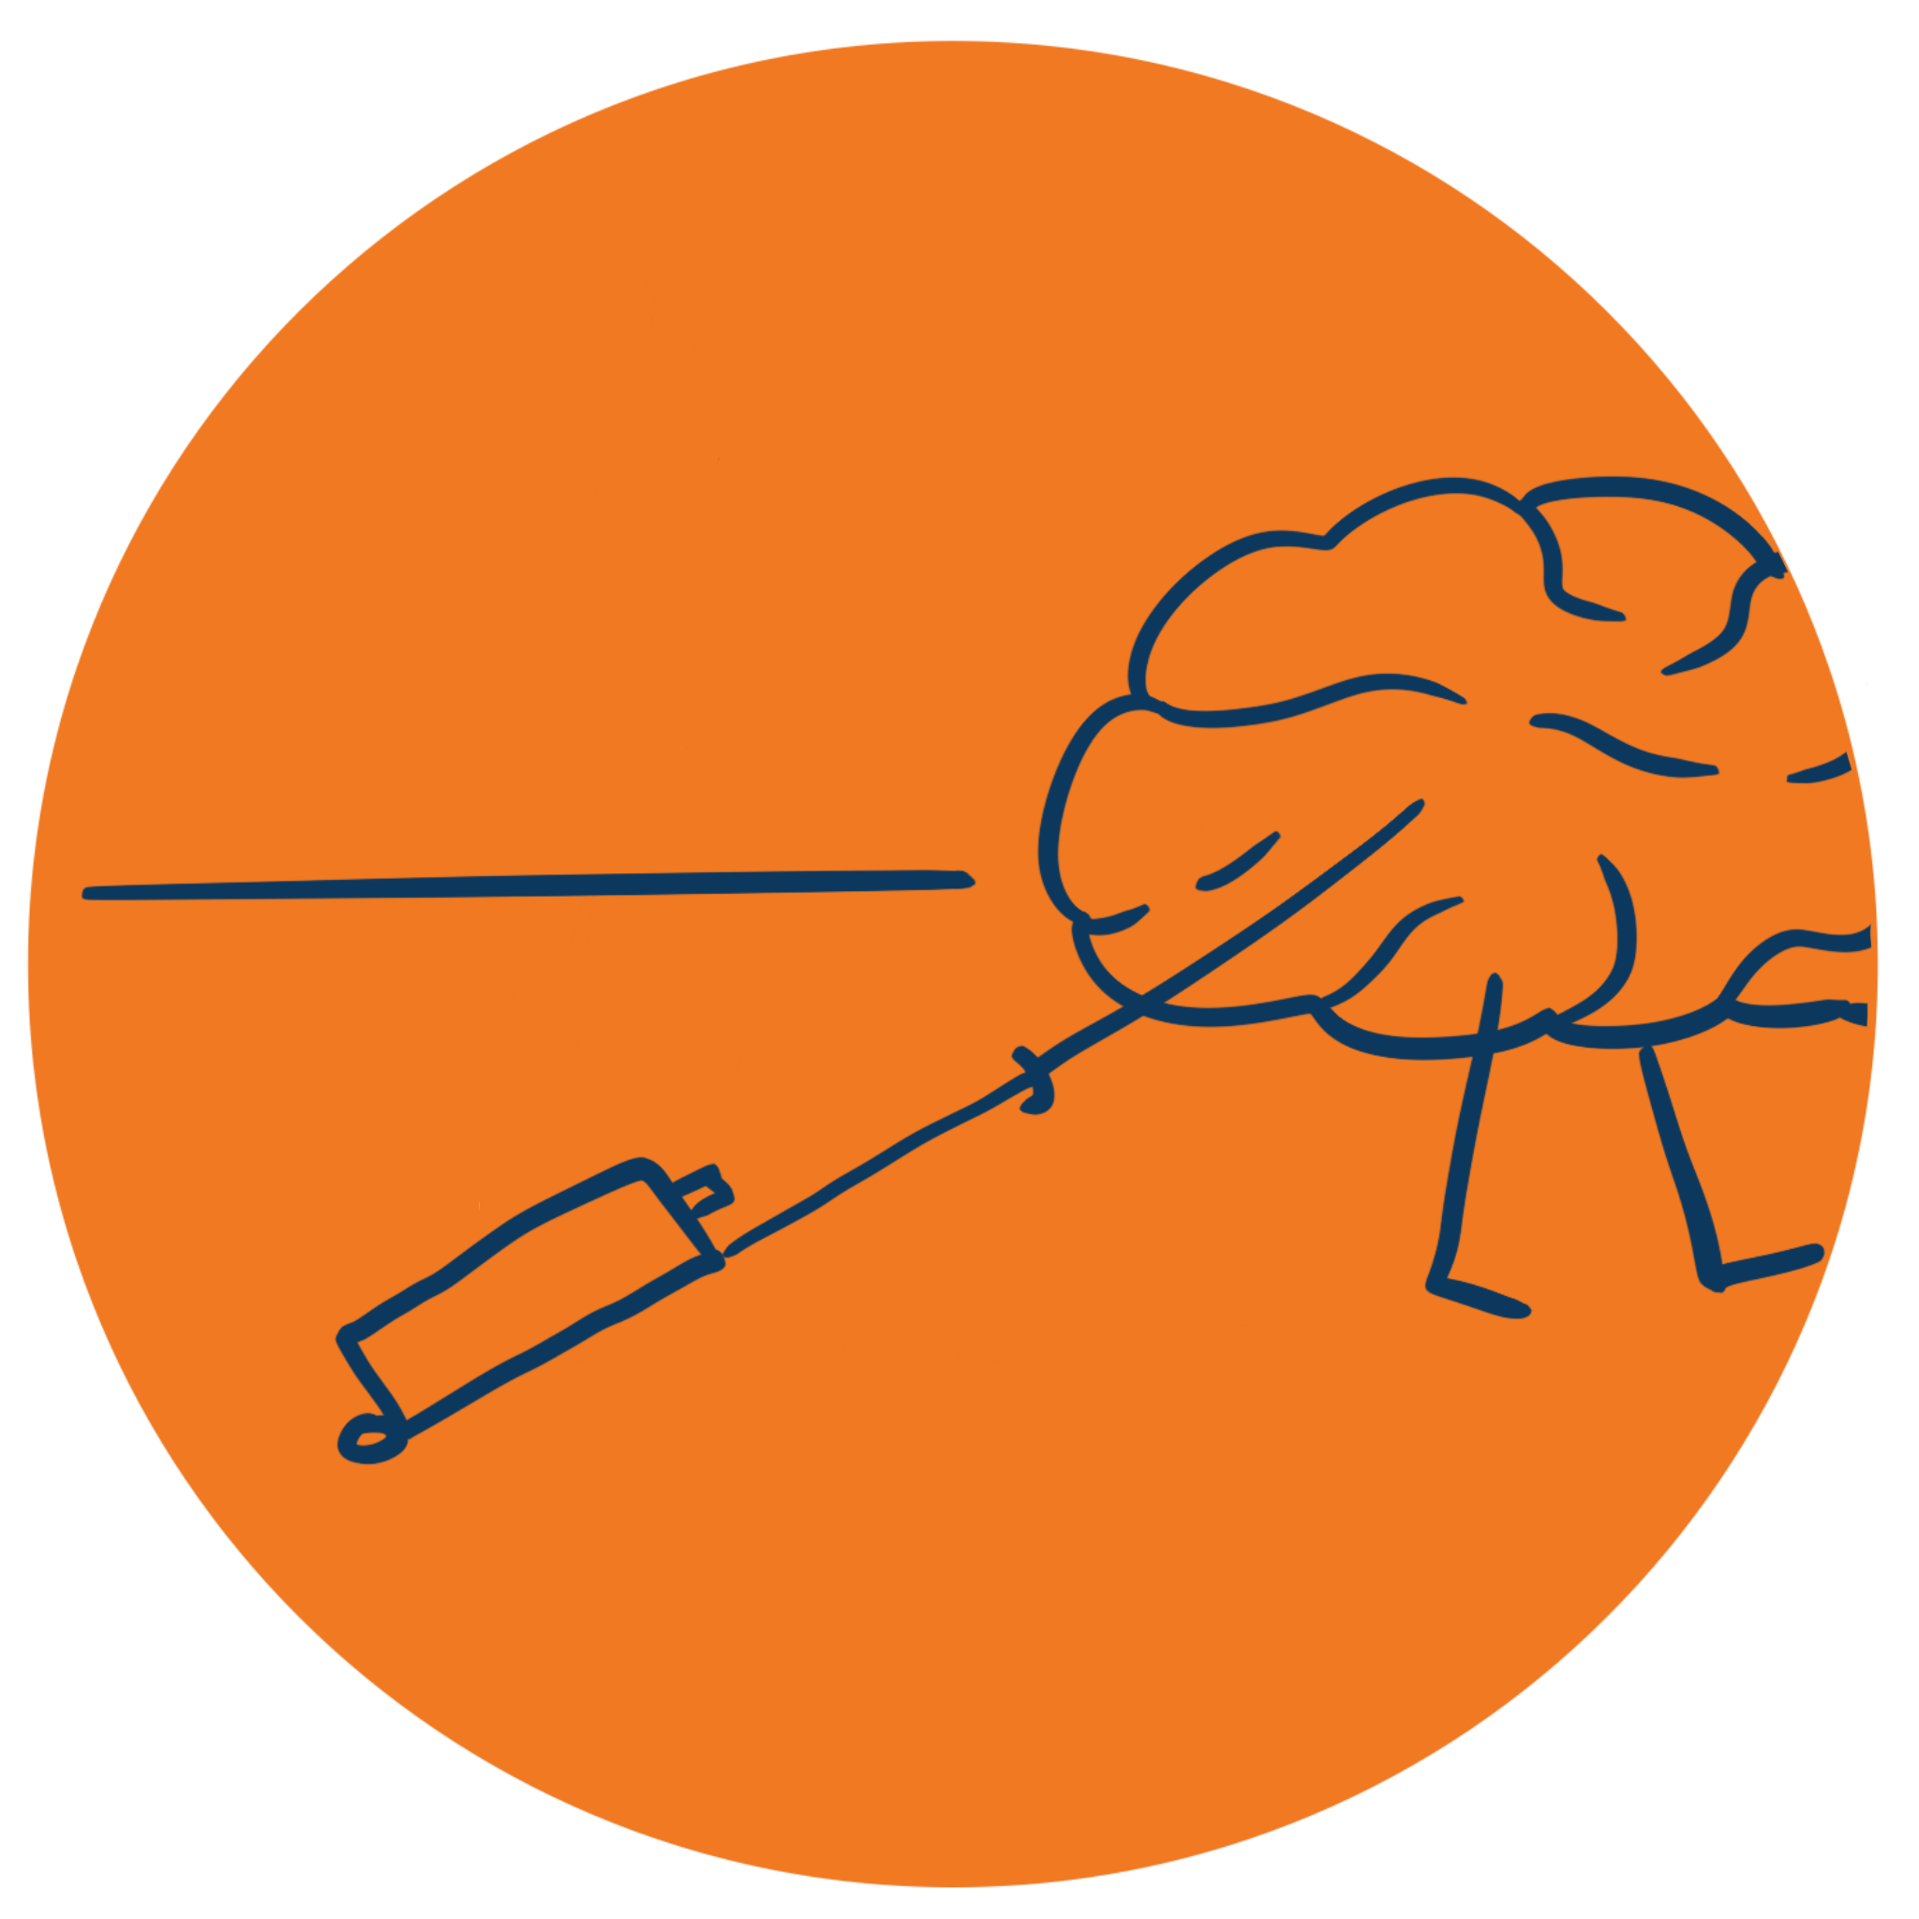
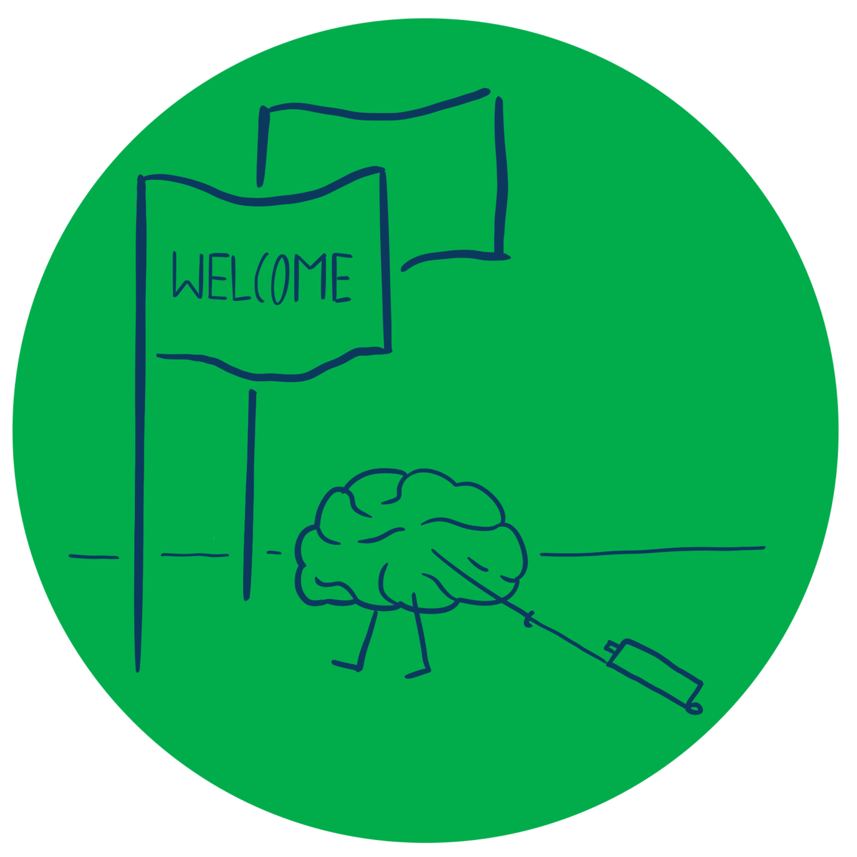
Entrepreneurship and New business creation
(2 ECTS, 50-60 h)
Notes:
Today's dynamic economy requires people who can take advantage of opportunities, take initiative and solve problems in creative ways. This course gives you the knowledge and skills to independently and critically approach the entrepreneurial processes that take place in all sectors of society, i.e. in businesses, in the public sector and in the civil society. It gives you tools to drive or facilitate entrepreneurship by starting your own business, developing local communities or to work with development processes in established companies, authorities, and non-profit organizations.

Slide 2
1. 2 The Entrepreneurial mindset
1.2.1 Character traits of entrepreneurs
1.2.2 Entrepreneurial behaviour
1.2.3 Cultural influences on creativity

Slide 3
Influences on our character traits
Situational factors
Cultures & sub-cultures
Personal character traits
Nationality
Education
Age
Family
Partnering
Gender
Immigration & ethnicity
Notes:
While we may have some inherent character traits, cognitive theory tells us that our character is the product of the many other influences that have shaped and developed us over our life. From our parents and family to our nationality and religion, from our education to our work careers. It is influenced by the culture of these different groups – their basic values, beliefs and norms of behaviour. This patchwork of cultural influences can explain a number of thing – for example, studies have shown that a family business background, such as having a parent who was an entrepreneur increases the probalility of staring up in business.
The demographics of entrepreneurship, discussed in 1.1.3, are influenced by these factors. We learn from our individual experiences of life.

Slide 4
Dimenstions of culture
Individualism v collectivism – the degree to which people prefer to act as individuals rather than as groups
Power distance – the degree of inequality accepted by the community
Uncertainty avoidance – the degree to which people avoid ambiguity/uncertainty & prefer structure
Masculinity vs femininity – quality of life issues like individual achievement & assertiveness vs relationships & concern for others
Notes:
National culture is seen as a major influence on individual behaviour. See for example the Hofstede model. Hofstede undertook an extensive cross-cultural study, Resulting in the next figure -

Slide 5
Hofstede’s dimension of National cultures
Low
High
South America, Saudi Arabia, Pakistan
INDIVIDUALISM
USA, UK, France, Australia, Canada
USA, UK, Germany, Scandinavia
POWER DISTANCE
South America, France, Malaysia, Saudi Arabia
USA, UK, Hong Kong, Singapore
UNCERTAINTY AVOIDANCE
Greece, France, Portugal, Uruguay, Saudi Arabia
MASCULINITY
USA, Austria, UK, Japan, Germany
North Europe
Entrepreneurial cultures
Notes:
Burns (2022, p. 69) based on text of Hofstede (1981)

Slide 6
Entrepreneurs – born or made?
This video discusses whether entrepreneurs are predominantly born with certain character traits or whether these traits result from their various cultural influences

Slide 7
Meyer’s cultural influences
Communicating
simple vs nuanced
Evaluating
direct vs indirect criticism
Persuading
theory vs application
Leading
high vs low power distance
Deciding
group vs individual
Trusting
task (head) vs relationship (heart)
Disagreeing
comfortable vs uncomfortable
Scheduling
flexible vs inflexible

Slide 8
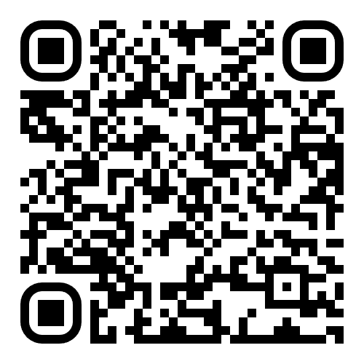
Assignment
Take Meyer’s cultural influences test . Consider whether this explains any of the characteristics shown in the GET2 test. Discuss the results with the rest of the class, trying to understand the reasons for similarities and differences.
Meyer’s cultural assessment tool

Slide 9
Acknowledgments
Part of the Education Material produced within the Erasmus+ Project: ENDORSE
Project Partners:
ENDORSE Educational Material Entrepreneurship © 2024 by ENDORSE is licensed under CC BY-SA 4.0
Logos of Partner Institutions and Erasmus+ are excepted.
Although we researched carefully there is still the possibility for mistakes – review the Material for your use cases. Please note that we are not responsible for the content of any linked site or any link contained in a linked site.

