Slide 1
Entrepreneurship and New business creation
(2 ECTS, 50-60 h)
Notes:
Today's dynamic economy requires people who can take advantage of opportunities, take initiative and solve problems in creative ways. This course gives you the knowledge and skills to independently and critically approach the entrepreneurial processes that take place in all sectors of society, i.e. in businesses, in the public sector and in the civil society. It gives you tools to drive or facilitate entrepreneurship by starting your own business, developing local communities or to work with development processes in established companies, authorities, and non-profit organizations.

Slide 2
1. 3 Entrepreneurial activities
1.3.1 Ideas
1.3.2 Opportunity evaluation and market research
Notes:
Today's dynamic economy requires people who can take advantage of opportunities, take initiative and solve problems in creative ways. Entrepreneurship is a way of thinking and acting where you can use your passion for innovation whether you plan to start your own business, or plan to work within an organisation, or develop an understanding of business operations and leadership. This course gives you the knowledge and skills to independently and critically approach the entrepreneurial processes that take place in all sectors of society, i.e. in businesses, in the public sector and in the civil society. It gives you tools to drive or facilitate entrepreneurship by starting your own business, developing local communities or to work with development processes in established companies, authorities, and non-profit organizations.

Slide 3
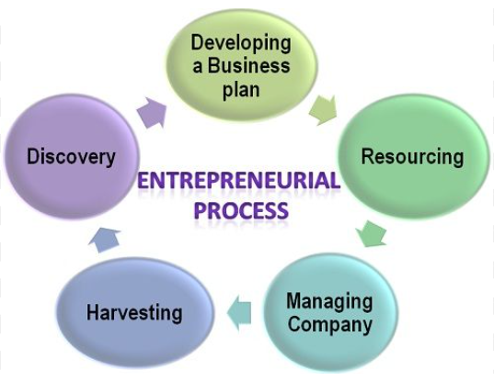
The Entrepreneurial process - what do we mean?
Discovery
Idea Generation
Parsadi, 2023
Business Jargons, 2023
Notes:
Different views of this, but start with an idea/ discovery of an opportunity

Slide 4
Business ideas
Problem
Analysis
Solution
Find a way a producing the solution at a price customers are willing to pay
Notes:
Good business ideas are usually based around finding a solution to a problem that somebody is willing to pay for.

Slide 5
New venture typologies
4
Radical innovation
6
New-to the-world-industries
Radical product/service innovation
2
Incremental innovation
Incremental product/service innovation
Increasing
risk
1
Copycat
3
Market expansion
5
Market paradigm shift
Existing product/service
Existing market
Incrementally new market
Radically new market
Notes:
The figure shows six generalised types of new venture, depending upon how innovative the product/service and how new the market is.
5

Slide 6
Product/service innovation
Developments in technology
from radical to incremental
Improvements in design or functionality
doing things better
Improvements in efficiency
doing things at lower cost
New combinations of marketing mix
ways of getting things to markets

Slide 7
Finding a business idea
Market need
Changes in technology, law & regulation, market & industry structures, demographics, culture, moods & fashions
Product deficiencies
Unmet demand
Create opportunity
Radical product or market innovation
Spot opportunity
Incremental product or market innovation
Notes:
There are two approaches finding a commercial business opportunity:
Spotting an opportunity or gap in the market wher current (or future) customer needs are not being met. This probably involves incremental changes to a product/service or market expansion.
Creating an opportunity by developing a new market through radical product/service innovation and/or market paradigm shift. This is an unproven market and therefore a riskier approach.

Slide 8
Symptoms of change
The unexpected
Incongruity
Inadequacy in underlying processes
Changes in industry or market structure
Demographic changes
Changes in perception, mood & meaning
New knowledge
Read also in: “Innovation and Entrepreneurship: Practice and Principles”, Peter F. Drucker, 1985

Slide 9
Techniques for exploring change
Political
Economic
Social
Technological
Economic
Legal
Spotting opportunity 1. Identify change 2. Link to business opportunity 3. Develop the idea
PESTEL analysis
Futures thinking
Scenario planning
Brainstorming
Mindmaps
Suspend disbelief

Slide 10
Assignment
Either for your own original business idea or one from an existing, but new idea, discuss:
A description of the product/service idea – its features
A description of the types of customers for it
Needs it will satisfy – benefits or the problems it solves
Names of competitors & why their product/service is not as good

Slide 11
Acknowledgments
Part of the Education Material produced within the Erasmus+ Project: ENDORSE
Project Partners:
ENDORSE Educational Material Entrepreneurship © 2024 by ENDORSE is licensed under CC BY-SA 4.0
Logos of Partner Institutions and Erasmus+ are excepted.
Although we researched carefully there is still the possibility for mistakes – review the Material for your use cases. Please note that we are not responsible for the content of any linked site or any link contained in a linked site.

