Slide 1
Entrepreneurship and New business creation
(2 ECTS, 50-60 h)
Notes:
Today's dynamic economy requires people who can take advantage of opportunities, take initiative and solve problems in creative ways. This course gives you the knowledge and skills to independently and critically approach the entrepreneurial processes that take place in all sectors of society, i.e. in businesses, in the public sector and in the civil society. It gives you tools to drive or facilitate entrepreneurship by starting your own business, developing local communities or to work with development processes in established companies, authorities, and non-profit organizations.

Slide 2
1. 4 Sustainability values
Business sustainability and social enterprises
Notes:
There is a long history of socially motivated entrepreneurs. More recently companies like Lush – see Burns page 256, case insight 11.5. and Timberland, page 458, case insight 20.4, managed to combine business and social values sucessfully – and in the process enhance thier brand image and make substntial profits.

Slide 3
Hierarchy of virtue
Ethical
motive
Legal compliance motive
Profit motive
Notes:
Another approach to this issue has been the emergence of what has become known as sustainable entrepreneurship. This is where issues of what is widely called corporate social responsibility (CSR) – ethics, environmental sustainability and good corporate governane, are at the core of the commercial entreprise. Iti is said to be about ”meeting the need of today through profit without prejudicing the future.
Social, environmental and ethical values are somthing that many individuals will identify with , whether entrepreneurs or customers. These can be reflected in the culture of a ffirm as well as its strategies and actions and utimately translate into a distinctive and attractive brand identity.
The figure depicts a hierarchy ofvirtue. At its bas is CSR that delivers profit to the company. Next is CSR that comes through compliance with the law. Finally there is CSR that is discretionary based upon ethical norms amd a disre to do the best thing for the community and society as a whole. Fortu

Slide 4
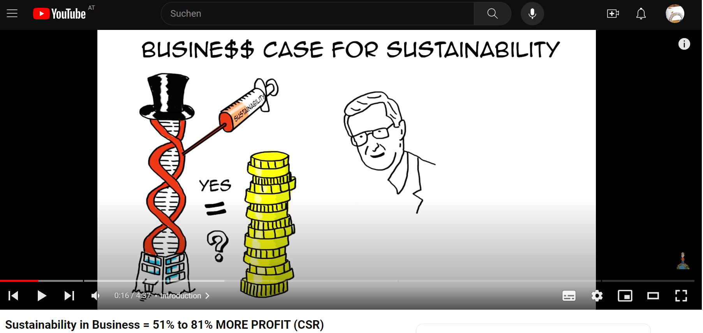
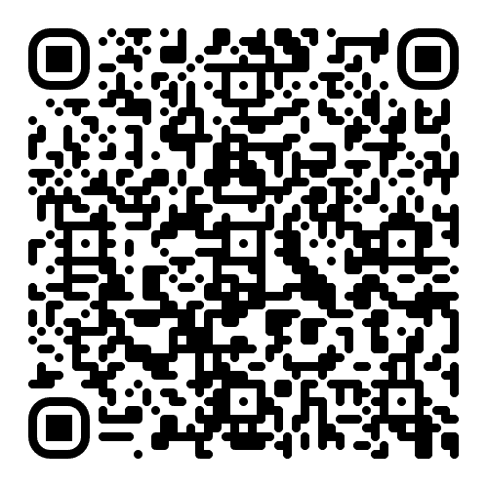
Corporate social responsibility - CSR
This is the first of a series of short animations making the business case for sustainability

Slide 5
Commercial advantages of CSR
Increased sales, brand identity & customer loyalty
Reduced operating costs & productivity gains
Improved new product development
Link to ICRS website
Notes:
Sustainable entrepreneurship can offer both commercial and social benefits, and the more a firm can benefit from CSR, the more it is likely to integrate it on a strategic decision-making level, simultaneously increasing its effectveness in promoting its CSR causes.

Slide 6
Three systems of the economy
Private sector
Public services & government
Global
National
Social/ voluntary economy
Regional
Local
Social enterprises
Community
Trading/market
Non-trading/planned
Notes:
Social entrepreneurs have many of the qualities of commercial entrepreneurs. In particular they are innovative, often creating creating change by doing things differently. They operate at the intersection of the public, voluntary and private sectors, pulling together resources with the purpose of serving their social mission.

Slide 7
Social enterprise criteria
Must have a clear social or environmental mission set out in their governing documents
Must generate the majority of their income through trade
Must reinvest the majority of their profit
Must be autonomous of the state
Must be majority controlled in the interests of the social mission
Must be accountable and transparent
Social Enterprise UK

Slide 8
Conflicts within social enterprise
Commercial vs social objectives
Democratic accountability
Nature of social objectives

Slide 9
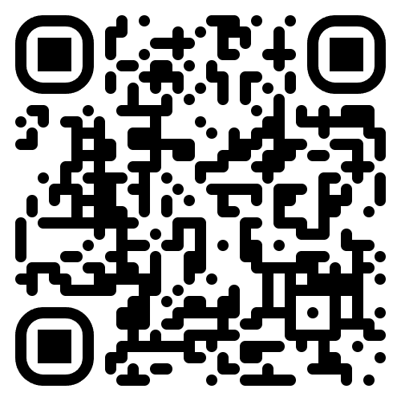
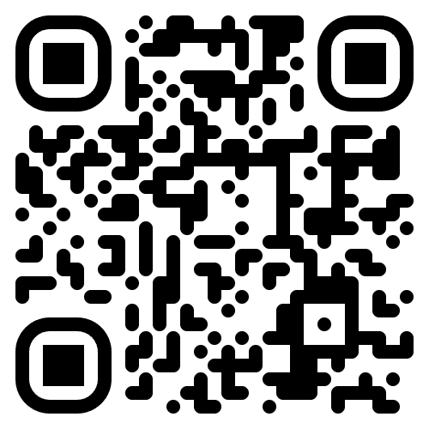
Assignment
The Big Issue is a street newspaper founded by John Bird and Gordon Roddick in September 1991 and published in four continents.
Is The Big Issue Group a good example of social entrepreneurship?
Notes:
Start looking at the film, then answering the questions.

Slide 10
Acknowledgments
Part of the Education Material produced within the Erasmus+ Project: ENDORSE
Project Partners:
ENDORSE Educational Material Entrepreneurship © 2024 by ENDORSE is licensed under CC BY-SA 4.0
Logos of Partner Institutions and Erasmus+ are excepted.
Although we researched carefully there is still the possibility for mistakes – review the Material for your use cases. Please note that we are not responsible for the content of any linked site or any link contained in a linked site.

