Slide 1
BUSINESS PLANNING AND THE ENTREPRENEURSHIP ECOSYSTEM (3 ECTS, 75-90 h)

Slide 2
2.2 Entrepreneurial ecosystem concept Film: 2.3

Slide 3
Why entrepreneurship ecosystem?
Notes:
Previous studies show that the nature and structure of entrepreneurship vary across countries and over time and further that the differences could partly be explained ‘by the marked interdependencies between economic development and institutions’ (Acs et al., 2011:393). Entrepreneurial ecosystems have gained attention in order to better understand the complex socio-economic structures and processes with many interactive elements that emphasize the interdependence between actors and factors, where entrepreneurship is regarded as the production of the entrepreneurial ecosystem (Acs et al., 2017). As entrepreneurship ecosystems take place in localities it is to be understood as involving local resources, institutions and networks (Malecki, 2018), meaning that entrepreneurship could be both enabled and constrained by its context (Acs et al., 2017).
The underlying idea in the ecosystem, as a metaphor for the entrepreneurship environment, lies in the fact that entrepreneurship's success or failure depends, in addition to its own actions, on several factors outside its own operations (c.f. Acs et al., 2017; Malecki, 2018). Such factors that have a direct or indirect impact on entrepreneurship results could be e.g. institutions and resources (Stam & van de Ven, 2021) as well as spatial infrastructure, knowledge dissemination and the spread of human capital as well as the effects of networks (Audretsch et al., 2018). Hence, the entrepreneurs become embedded in systems of facilitating or inhibiting elements. From the ecosystem perspective, entrepreneurship is formed by the factors that are outside the business, but companies in turn shape these factors through their activities.

Slide 4
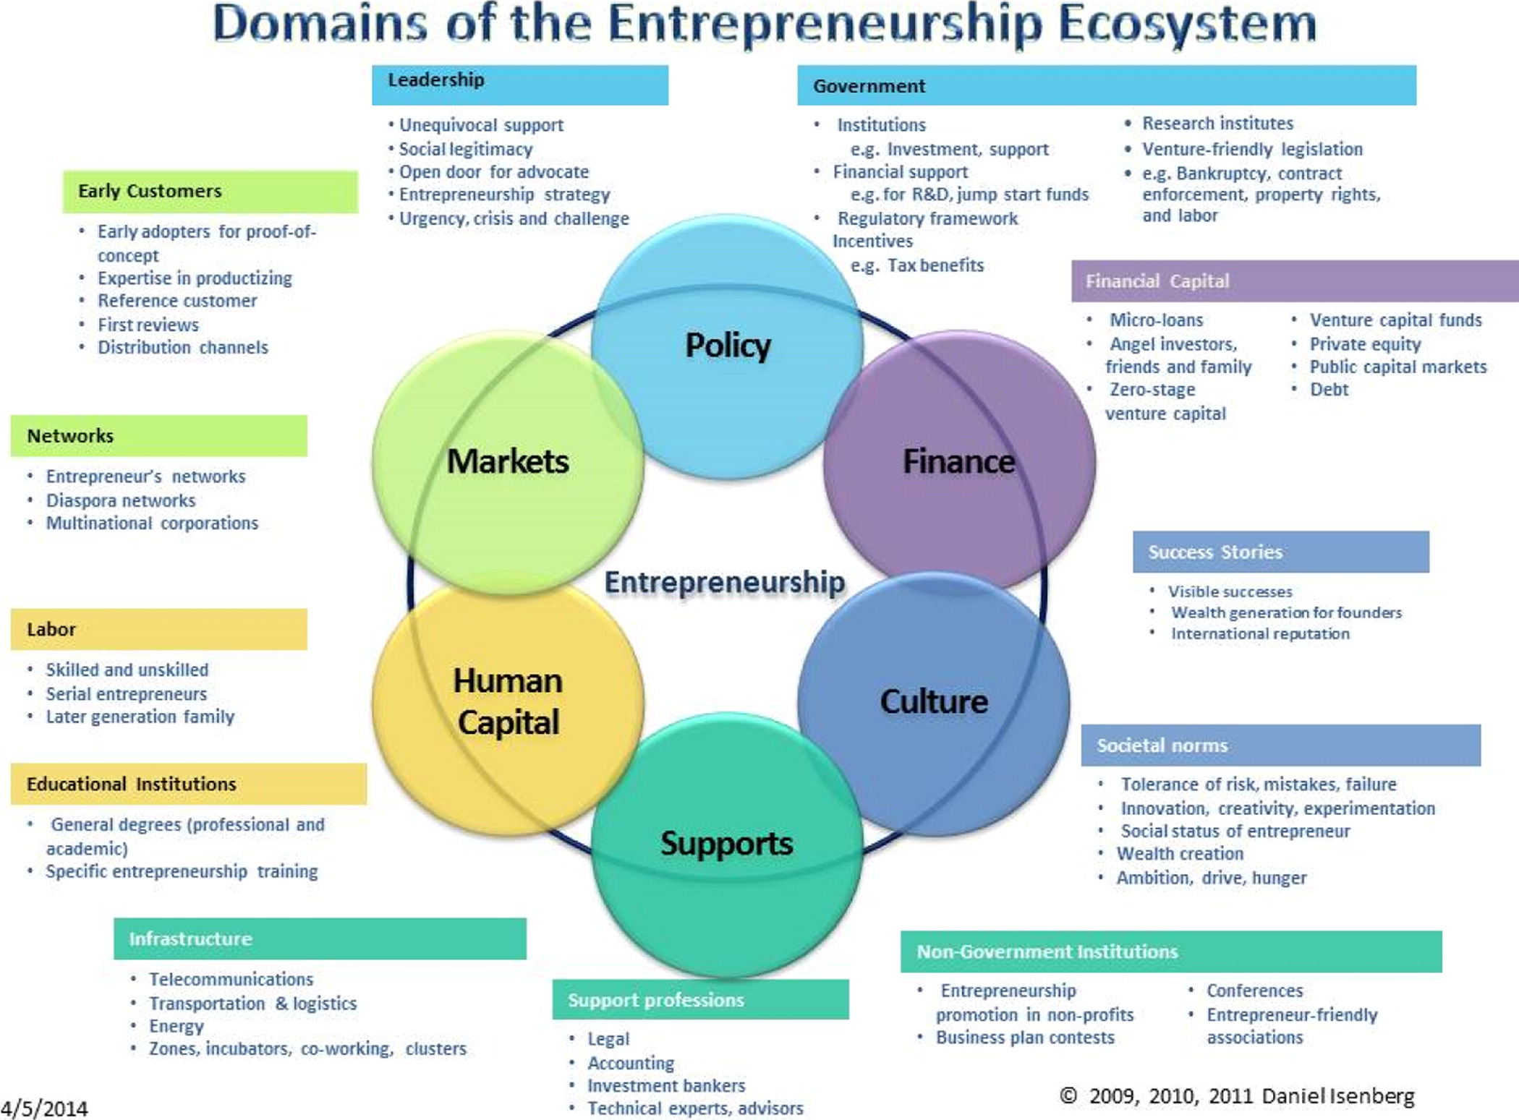
Entrepreneurship ecosystem
Source: Daniel Isenberg & Vincent Onyemah, Fostering Scale Up Ecosystems for Growth: The Cases of Manizales-Mas and Scale Up Milwaukee, Innovations: Technology, Governance, Globalization (forthcoming 2016).
Notes:
Malecki (2018) argues that entrepreneurship ecosystems are mainly found in localities and involve local resources, institutions and networks. As a result, any such ecosystem can be considered unique but previous studies show that there are some common key areas that interact in unique and complex ways and that affect the entrepreneurial ecosystem. Isenberg (2011) means that these key areas are: leading politics (leadership and governance), markets (early customers and networks), finance (financial capital), human capital (labour and educational institutions), culture (success stories and social norms), and support (infrastructure, advisors and non-governmental institutions).

Slide 5
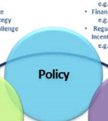
Policy Leadership
Unequivocal support
Social legitimacy
Open door for advocate
Entrepreneurship strategy
Urgency, crisis and challenge

Slide 6
Policy Governement
Institutions (e.g. investment, support)
Financial support (e.g. for R&D, jump start funds)
Regulatory framework incentives (e.g. tax benefits)
Research institutes
Venture-friendly legislation (e.g. bankruptcy, contract enforcement, property rights and labor)

Slide 7
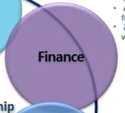
Finance Financial Capital
Micro-loans
Angel investors, friends and family
Zero-stage venture capital
Venture capital funds
Private equity
Public capital markets
Debt

Slide 8
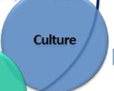
Culture Success stories
Visible successes
Wealth generation for founders
International reputation

Slide 9
Culture Societal norms
Tolerance of risk, mistakes, failure
Innovation, creativity, experimentation
Social status of entrepreneur
Wealth creation
Ambition, drive, hunger

Slide 10
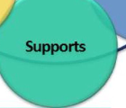
Supports Non-Government Institutions
Entrepreneurship promotion in non-profits
Business plan contests
Conferences
Entrepreneur-friendly associations

Slide 11
Supports Support Professions
Legal
Accounting
Investment bankers
Technical experts, advisors

Slide 12
Supports Infrastructure
Telecommunications
Transportation & logistics
Energy
Zones, incubators, co-working, clusters

Slide 13
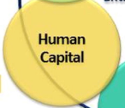
Human Capital Educational Institutions
General degrees (professional and academic)
Specific entrepreneurship training

Slide 14
Human Capital Labor
Skilled and unskilled
Serial entrepreneurs
Later generation family

Slide 15
Markets Networks
Entrepreneur’s networks
Diaspora networks
Multinational corporations

Slide 16
Markets Early Customers
Early adopters for proof-of-concept
Expertise in productizing
Reference customer
First reviews
Distribution channels

Slide 17
Factors affecting the business success and failure
Filmed entrepreneurs showing factors in entrepreneurship ecosystem affecting their businesses.
Available template on Teams
Austria is responsible for the films

