Slide 1
BUSINESS PLANNING AND THE ENTREPRENEURIAL ECOSYSTEM
(3 ECTS, 75-90 h)

Slide 2
2.4 Start-up
2.4.1 New Venture Creation Framework 2.4.2 Business Model Canvas

Slide 3
What is Business model?
This brief HBR video explains the difference between a strategy & a business model.

Slide 4
Advantages of using a business model framework
Allows elements of model to be easily modified
Allows innovative options to be explore in a structured way
Facilitates the understand of linkages between elements of the model
Allows the testing of new models against established ones
Allows experiment with different versions to see which critical assumptions are most realistic (revenue model; pricing, sales, costs etc.)
Helps identify patterns & ensure consistency in the elements of the model

Slide 5
The development phase of a Business model
This video explains the business model development phase of the Framework

Slide 6
Business Model Canvas
8. Key partnerships
The network of suppliers and partners that make the business model work
6. Key activities
The most important things you need to do to make the business model work
Value proposition
The product/ service bundle that creates value for each customer segment
3. Customer relations
The types of relationships you aim to have with each customer segment
2. Customer segments
The different groups of people or organizations you aim to reach
7. Key resources
The most important assets required to make the business
4. Channels
How you communicate with and reach each customer segment
9. Cost structures
All the costs that you will incur to operate your business model
5. Revenue streams
The cash generated from each customer segment

Slide 7
Lean Business Model Canvas
8. Key problems
The key problems that the value proposition seeks to address
(incl. in 4. Channels?)
6. Solutions
Solutions to problems (8)
Value proposition
The product/ service bundle that creates value for each customer segment
3. Unfair advantage:
Competitive advantage
2. Customer segments
The different groups of people or organizations you aim to reach
7. Key metrics
The few actions that matter
(6. Key activities?)
4. Channels
How you communicate with and reach each customer segment
9. Cost structures
All the costs that you will incur to operate your business model
5. Revenue streams
The cash generated from each customer segment

Slide 8
Concept development cycle
Operational relatedness & strategic importance
Market/ industry research
Commercial viability
Go/no-go decision point
Idea
generation
1
Initial screening
4
MVP development
5
Market testing
6
Business model & strategy formulation
Product launch
2
Concept
development
3
Product specification
Measurement against performance metrics & feedback
Concept testing and feedback

Slide 9
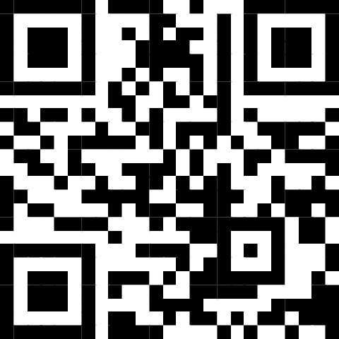
Business Model Canvas
The Business Model Canvas & other online tools to help apply it are available to download here
These video animations that explain how to use the Canvas
1
2
3
4
5
6
https://tinyurl.com/55crdscy

Slide 10
Acknowledgments
This Material is Part of the Education Package produced within the Erasmus+ Project: ENDORSE
Project Partners:
ENDORSE Educational Material Entrepreneurship © 2024 by ENDORSE is licensed under CC BY-SA 4.0
Logos of Partner Institutions and Erasmus+ are excepted.

