Slide 1
BUSINESS PLANNING AND ENTREPRENEURIAL ECOSYSTEM
(3 ECTS, 75-90 h)

Slide 2
2.5 Developing the Business Model

Slide 3
Values, vision & mission
Values are core beliefs
Mission is a statement of business purpose
Vision is a view of what the business might become

Slide 4
Mission statement template
(The company) aims to use its (competitive advantage) to achieve/maintain (aspirations) in providing (product/business scope) which offers (value proposition) to satisfy the (needs) of (customer segments).
In doing this the company will at all times strive to uphold (values).
Wickham 2001

Slide 5
Communicating vision
Keep it simple
Use metaphors, analogies & examples
Use many different forums
Repeat the message
Lead by example
Address small inconsistencies
Listen & be listened to

Slide 6
Strategy development
Enduring
Changing
Values
Mission
Vision
Goals
Strategy
Tactics
Long-term
Short-term

Slide 7
Generic business models
Customer intimacy or focus
High
Operational efficiency
Low cost
Product leadership
High differentiation
High
High

Slide 8
Generic business models & price
High
Niche business model
Higher price
Differentiation
Lower price
Low price or commodity business model
Low
High
Customer intimacy or focus

Slide 9
Generic strategies & business imperatives
High differentiation
Understand basis for differential advantage
Build on differential advantage
Build barriers to entry
Build brand
Continuous innovation
Encourage creativity & innovation
Customer focus
Maintain close customer relationships
Keep in touch with & monitor customer needs
Maintain customer loyalty
Maximize sales to loyal customers (economies of scope)
Build brand
Low price / cost
Maintain cost leadership through economies of scale
Continually drive down costs
Achieve high sales volumes
Improve efficiency
Standardization

Slide 10
Questions to ask in deciding on strategy
For each dimension, what proportion of customers focus on it as their primary or dominant decision criterion? How important is each value discipline to each market segment?
Which competitors provide the best value in each of these value dimensions? Who is the major competitor in each discipline?
How does this product/service compare to the competition on each dimension?
If it falls short of the value leaders in each dimension, how can this be remedied?

Slide 11
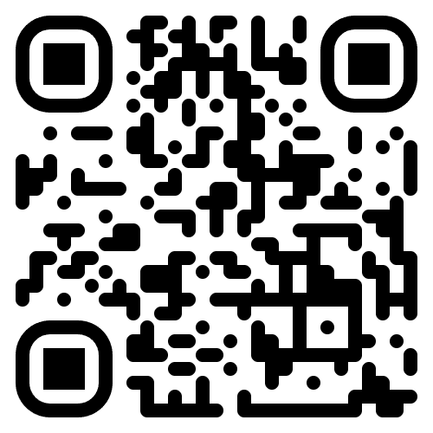
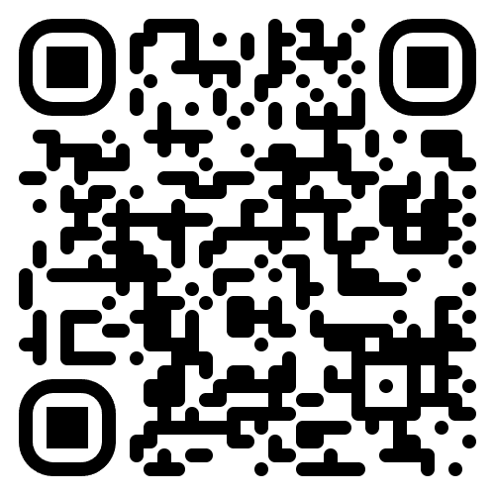
Morgan Motor Company (1)
Why is this a niche business?
What are the pros and cons of this business model for Morgan?
https://morgan-motor.com/
https://www.youtube.com/watch?v=OJLcoGMPQ94

Slide 12
Internet business models
Direct sales (Amazon)
Bricks-&-clicks (John Lewis)
Subscription (The Times newspaper)
Affiliate (Amazon, eBay)
Pay-as-you-go (smartphones)
Freemium (Spotify)
Auction (eBay)
Flash sales (Groupon)
Bait-&-hook (smartphones)
Advertising (YouTube, Facebook)
Pay-per click (Google)
Open (comparison websites)
Multi-sided market
Free to user + 3rd party data sale (Facebook)

Slide 13
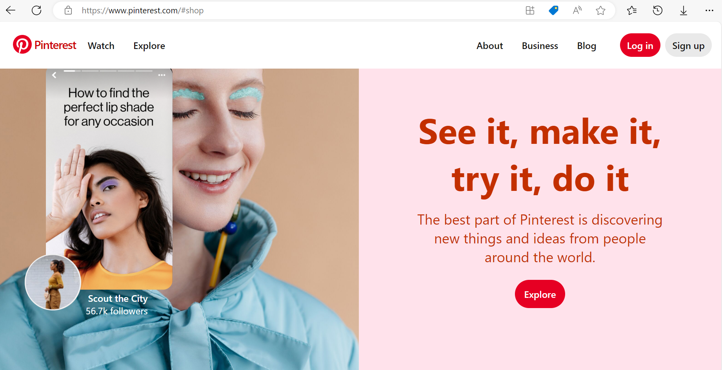
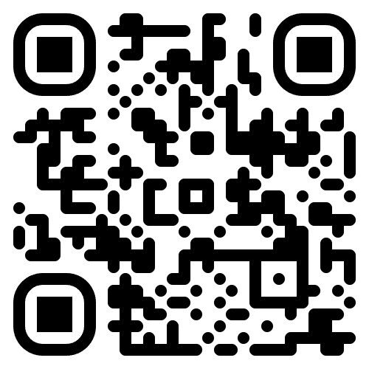
Pinterest
Which business models would you apply to Pinterest?
The inspiration for Pinterest came from a failed idea for an app called Tote. What are the potential effects on an entrepreneur of a failure like this?
https://www.pinterest.com/

Slide 14
Strategies to secure sustainable competitive advantage
Speed to market - first-mover advantage
Speed of market dominance – this gives market power, so it is generally better to dominate a small market than to be a small player in a big market
Strength of brand - this is the tool that helps carve out market dominance

Slide 15
Keeping strategies simple
This is a short talk by Donald Sull on the importance of keeping strategies simple

Slide 16
Characteristics of attractive business models
Identified market need or gap
No or few existing competitors
New or growing market
Low funding requirement
Clearly identified customers & viable business model
Sustainable
High profit margins
Effective communications strategy
Not easily copied
Identifiable risks that can be monitored & mitigated
Low fixed costs
Controllable
Management skills that can be leveraged
Scalable
Financeable

Slide 17
Assignments
List your values & beliefs. List your ethical, social & environmental concerns. How could these to be reflected in a start-up: its business model & its relationship with stakeholders?
Find a SME that describes itself as a niche business & analyse its business model. Do you agree that it is a niche business?

Slide 18
Acknowledgments
This Material is Part of the Education Package produced within the Erasmus+ Project: ENDORSE
Project Partners:
ENDORSE Educational Material Entrepreneurship © 2024 by ENDORSE is licensed under CC BY-SA 4.0
Logos of Partner Institutions and Erasmus+ are excepted.

