Slide 1
Module implementation, framework
Lecture about national and regional characteristics related to:
Legal forms
Rules and legalisations
Regional support structure (overview of the system)
Networks (local and regional)
Copyright protection

Slide 2
Founding a business in Germany
Comprehensive information on starting a business in Germany can be found here:
https://gruenderplattform.de/
https://www.existenzgruendungsportal.de/Navigation/DE/Home/home.html
https://www.wir-gruenden-in-deutschland.de/

Slide 3
Legal Forms in Germany
Founders in Germany can choose between several legal forms:
Einzelunternehmen
GbR
eingetragene Kauffrau (e.Kfr.) bzw. eingetragener Kaufmann (e.Kfm.)
OHG
KG
GmbH
UG (haftungsbeschränkt)
AG
The main difference in legal forms is liability. Other criteria are whether to start alone or with one or more partners, and the minimum capital.
Further information: https://www.existenzgruendungsportal.de/Navigation/DE/Gruendungswissen/Rechtsformen/rechtsformen.html

Slide 4
Funding opportunities in Germany
There are various financing options for start-up projects: Start-up loan, equity capital or funding
Here you will find information about the various possibilities:
https://gruenderplattform.de/finanzierung-und-foerderung/finanzierung-finden/finanzierungsmoeglichkeiten
https://www.foerderdatenbank.de/FDB/DE/Foerderprogramme/foerderprogramme.html
https://www.exist.de/EXIST/Navigation/DE/Gruendungsfoerderung/EXIST-Gruendungsstipendium/exist-gruendungsstipendium.html
https://www.wirtschaft.nrw/finanzierungsangebote-im-bereich-gruendungen
https://www.gründungsstipendium.nrw/gruenden

Slide 5
Copyright protection in Germany
You have a business idea and want to protect it from imitators:
https://gruenderplattform.de/startup-gruenden/patent-anmelden

Slide 6
Networks in Germany
Overview of many different networks on different topics:
Networks for women
Founding with a history of immigration
Entrepreneurship for the common good
and many more
Link:
https://www.existenzgruendungsportal.de/Navigation/DE/Netzwerke/Ueberregional/ueberregional.html

Slide 7
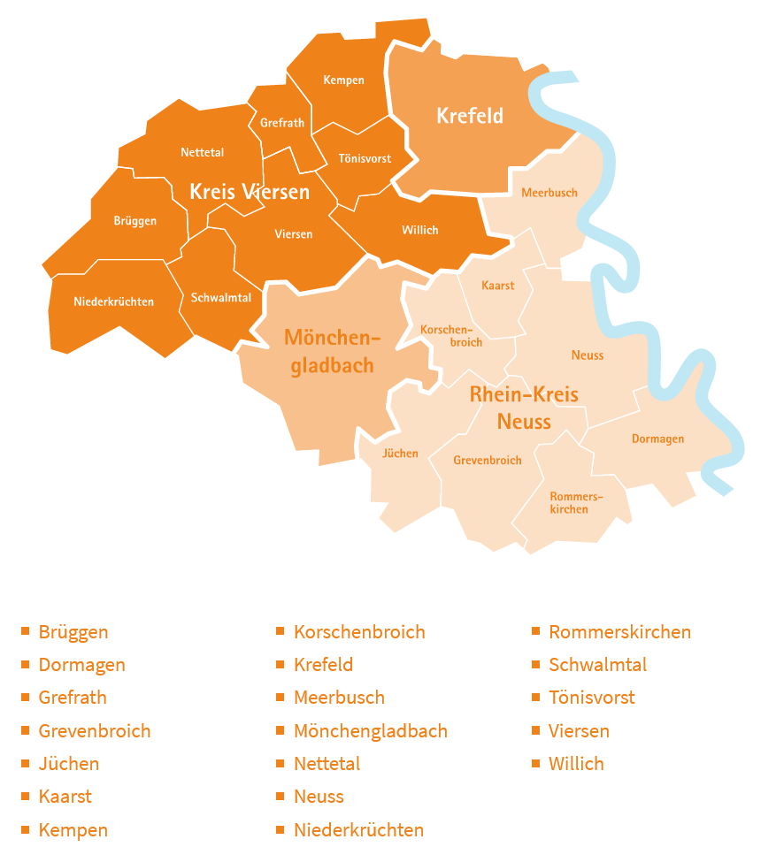
Contacts and Networks in the Middle Lower Rhine region
Overview of contact persons:
https://www.gruendungsregion-niederrhein.de/ansprechpartner/
Overview of networks:
https://www.gruendungsregion-niederrhein.de/netzwerke/networking/
Source: https://www.gruendungsregion-niederrhein.de/ansprechpartner/

Slide 8
HNX - Start-up team at Hochschule Niederrhein
HNX offers:
Consulting & Coaching
Funding & Finances
Networking & inspiration
Interesting facts & workshops
StartUpLabs
Workshop & Labs
Link: https://www.hs-niederrhein.de/existenzgruendung/

