Slide 1
Module implementation, framework
Lecture about national and regional characteristics related to:
Legal forms
Rules and legalisations
Regional support structure (overview of the system)
Networks (local and regional)
Copyright protection

Slide 2
Poland
Comprehensive information on starting a business in Poland can be found here:
https://www.biznes.gov.pl/en/portal/0621

Slide 3
Legal forms of running a business in Poland
one-person business activity
civil law partnership
limited liability company
joint-stock company
partnerships: general partnership, professional partnership, limited partnership, partnership limited by shares
Further information: https://www.biznes.gov.pl/en/portal/004056#1

Slide 4
Registration of a business
on – line:
https://www.biznes.gov.pl/en/e-uslugi/00_0736_00
with bank

Slide 5
Taxes
income taxation for one-person business activity:
under general rules, according to a tax scale (12% and 32% tax rates)
flat rate tax (rate of 19%)
lump sum tax on registered revenues.
VAT
Further information: https://www.biznes.gov.pl/en/portal/001823#7

Slide 6
Copyright protection in Poland
Information at:
https://uprp.gov.pl/pl/przedmioty-ochrony##googtrans(pl|en)
http://www.copyright.gov.pl/pages/main-page/copyright-in-poland/general-information.php

Slide 7
Organizations that offer support and advice in Poland
https://www.en.bgk.pl/
https://www.paih.gov.pl/pl
https://ksfp.org.pl/
http://www.parp.gov.pl/

Slide 8
Bussines Networks in Poland
Links:
https://lewiatan.org/
https://federacjaprzedsiebiorcow.pl/en/
https://siecprzedsiebiorczychkobiet.pl/
https://www.bnipolska.pl/

Slide 9
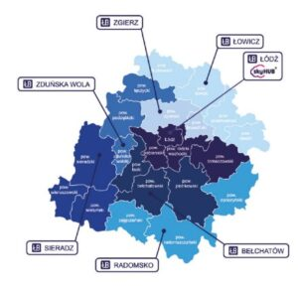
Regional support organizations in Lodzkie region
https://www.frp.lodz.pl/
https://startupy.lodz.pl/
https://inkubator.org.pl/
https://biznes.lodzkie.pl/w-wojewodztwie-lodzkim-przekujesz-pomysl-w-biznes/
Source: https://www.gruendungsregion-niederrhein.de/ansprechpartner/

Slide 10
Entrepreneurship support at the University of Lodz
Links:
Academy of Entrepreneurship: https://www.przedsiebiorczosc.uni.lodz.pl/en/
EkSoc startUP! Competition: https://www.eksoc.uni.lodz.pl/en/collaboration/companies-and-institutions/eksoc-startup-competition
Technology Transfer: https://www.ctt.uni.lodz.pl/en/cooperation/technology-transfer

