Slide 1
Module implementation, framework
Lecture about national and regional characteristics related to:
Legal forms
Rules and legalisations
Regional support structure (overview of the system)
Networks (local and regional)
Copyright protection

Slide 2
Founding a business in Sweden
Comprehensive information on starting a business in Sweden can be found here:
https://www.verksamt.se (Swedish and English)
https://www.foretagarna.se/driva-eget-foretag/starta-eget-foretag/guide-till-att-starta-eget/
https://www.almi.se
https://nyforetagarcentrum.se

Slide 3
Legal Forms in Sweden
Founders in Sweden can choose between several legal forms:
Aktiebolag
Enskild näringsverksamhet
Handelsbolag
Kommanditbolag
Ekonomisk förening
The main difference in legal forms is liability. Other criteria are whether to start alone or with one or more partners, and the minimum capital.
Further information:
https://verksamt.se/en/setting-up/choose-business-type

Slide 4
Funding opportunities when starting a business in Sweden
There are various financing options for start-up projects:
Own funds
Bank loans
Venture capital
Business angels
Public funding
Crowdfunding
Here you will find information about funding possibilities:
https://verksamt.se/en/financing-business-advice/financing-your-start#forms-of-financing
https://arbetsformedlingen.se/for-arbetssokande/extra-stod/stod-a-o/starta-eget-stod-till-start-av-naringsverksamhet

Slide 5
Copyright protection in Sweden
You have a business idea and want to protect it from imitators:
https://verksamt.se/en/intangible-assets/copyright
https://www.prv.se/en/copyright/

Slide 6
Organizations that offer support and advice in Sweden
https://verksamt.se/
https://www.almi.se/en/
https://midchamber.se
https://www.swedenabroad.se/en/about-sweden-non-swedish-citizens/business-and-trade-with-sweden/
https://nyforetagarcentrum.se
https://www.business-sweden.com/sv/
https://enterpriseeurope.se/in-english.html
https://www.prv.se/en/about-us/contact/
https://www.skatteverket.se/
https://www.tullverket.se/en/startpage.4.a62602917de14e432714e9.html

Slide 7
Regional support organizations in Mid- Sweden
https://midchamber.se
https://www.nyforetagarcentrum.se/jamtland
https://www.nyforetagarcentrum.se/sundsvall
https://businessregionmidsweden.se
https://bizmaker.se
https://peakinnovation.se
https://www.rvn.se/sv/utveckla-vasternorrland/stod-och-finansiering/foretagsstod/
https://www.regionjh.se/regionalutveckling/foretagsochprojektstod/foretagsstod.4.15591b8415700f7566b43c6a.html

Slide 8
Checklist for starting a business
https://verksamt.se/starta-foretag/checklista (Swedish)

Slide 9
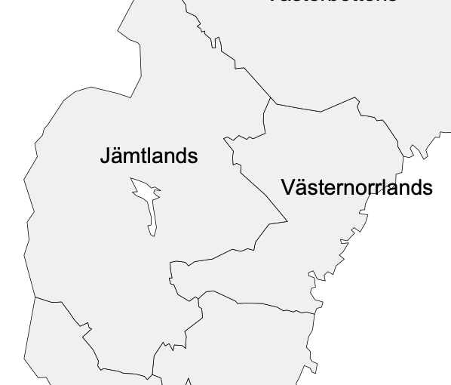
Contacts and Networks in the regions of Jämtland Härjedalen and Västernorrland
Overview of networks:
https://businessregionmidsweden.se/natverk/
https://www.foretagarna.se/regioner/vasternorrland/
Source: https://www.gruendungsregion-niederrhein.de/ansprechpartner/

Slide 10
Start-up team at Mid Sweden University
MIUN innovation:
Consulting & Coaching to employees and students
Networking & inspiration
Interesting facts & workshops
Link: https://www.miun.se/medarbetare/forskning/miuninnovation/

